Slide 1
Windows Form
Course Code: CSC 3115
Course Title: Object Oriented Programming 2
Dept. of Computer Science
Faculty of Science and Technology
Lecturer No: | 09 & 10 | Week No: | 10 & 11 | Semester: | Summer 2019-2020
Lecturer:

Slide 2
Lecture Outline
Basics of Windows Form Application.
Using Different components of Windows Form Application.
C# Graphical User Interface.
Multiple Form Interaction.

Slide 3
Windows Forms Application

Slide 4
Windows Forms Application
Windows Forms is a Graphical User Interface(GUI) class library which is bundled in .Net Framework or Mono Framework .
Its main purpose is to provide an easier interface to develop the applications for desktop, tablet, PCs.
It is also termed as the WinForms.
The applications which are developed by using Windows Forms or WinForms are known as the Windows Forms Applications that runs on the desktop computer.
WinForms can be used only to develop the Windows Forms Applications not web applications.
Providing a platform to write rich client applications.
WinForms applications can contain the different type of controls like labels, list boxes, tooltip etc.
Now lets work how to create an Windows Forms Application

Slide 5
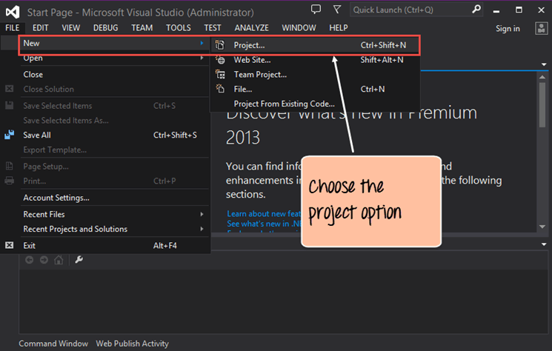
Step 1) The first step involves the creation of a new project in Visual Studio. After launching Visual Studio, you need to choose the menu option New->Project.

Slide 6
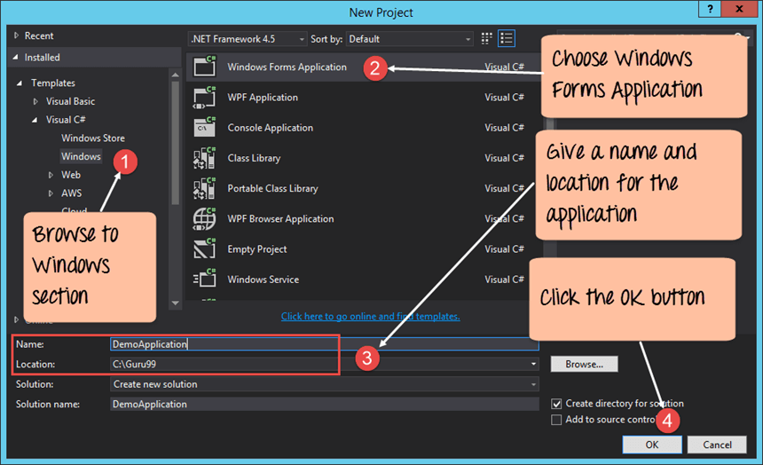
Step 2) The next step is to choose the project type as a Windows Forms application. Here we also need to mention the name and location of our project

Slide 7
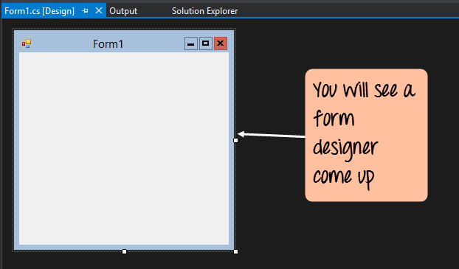
Windows Forms Application
In the project dialog box, we can see various options for creating different types of projects in Visual Studio. Click the Windows option on the left-hand side.
When we click the Windows options in the previous step, we will be able to see an option for Windows Forms Application. Click this option.
We then give a name for the application which in our case is DemoApplication. We also need to provide a location to store our application.
Finally, we click the 'OK' button to let Visual Studio create our project.

Slide 8
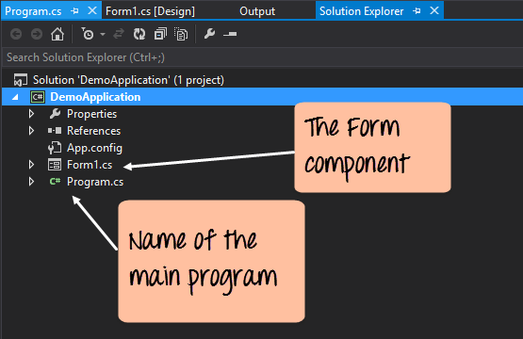
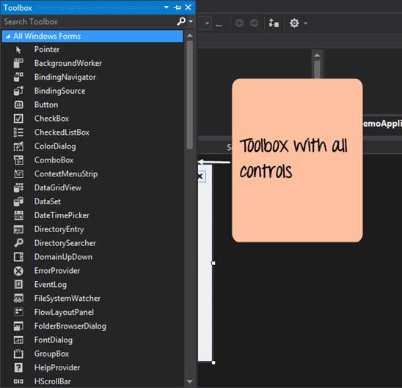
The toolbox contains all the controls which can be added to a Windows Forms. Controls like a textbox, label, button etc. Drag and drop the controls that you needed on created Form.

Slide 9
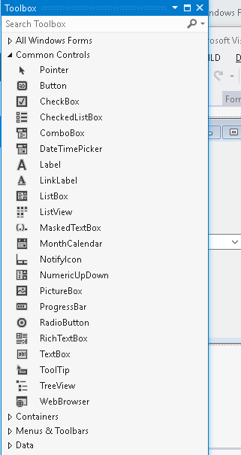
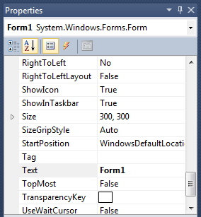
In properties panel you can configure your controls like their size, color, name etc.
In ToolBox panel you can find all the controllers for your project.

Slide 10
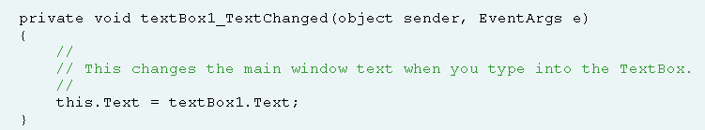
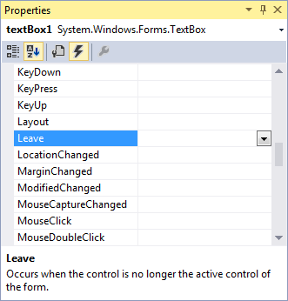
Events
Events are user actions such as key press, clicks, mouse movements, etc., or some occurrence such as system generated notifications. Applications need to respond to events when they occur. For example, interrupts. Events are used for inter-process communication.

Slide 11
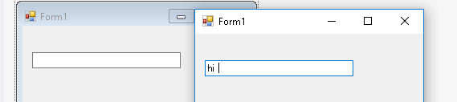
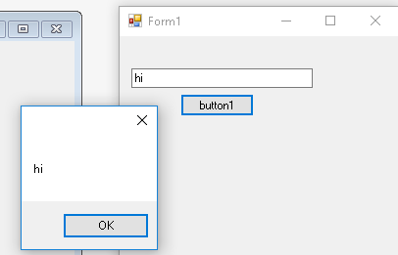
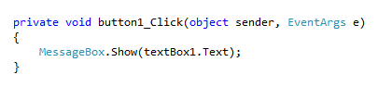
Control Details
TextBox : A TextBox control is used to display, or accept as input, a single line of text. TextBox controls can also be used to accept passwords and other sensitive information.
Button : A button accepts clicks. In Windows Forms we use a Button control that accepts click events and performs other actions in the user interface. This control provides a way to accept input—and invoke logic based on that input.
Button click event

Slide 12
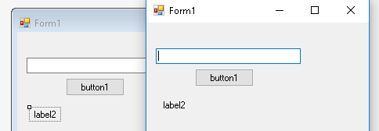
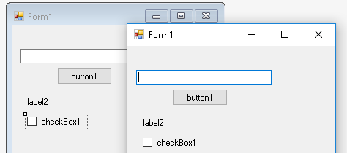
Control Details
Label : A Label control is used as a display medium for text on Forms. Label control does not participate in user input or capture mouse or keyboard events.
CheckBox : A CheckBox control allows users to select single or multiple items from a list of items.

Slide 13
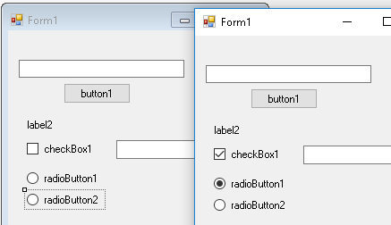
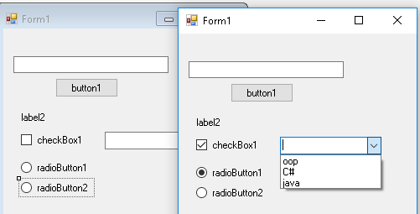
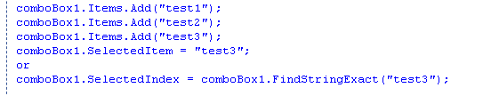
Control Details
RadioButton : A RadioButton control provides a round interface to select one option from a number of options. Radio buttons are usually placed in a group on a container control, such as a Panel or a GroupBox, and one of them is selected.
ComboBox : A ComboBox control provides combined functionality of a text box and a listbox in a single control. Only one list item is displayed at one time in a ComboBox and rest of the available items are loaded in a drop down list.

Slide 14
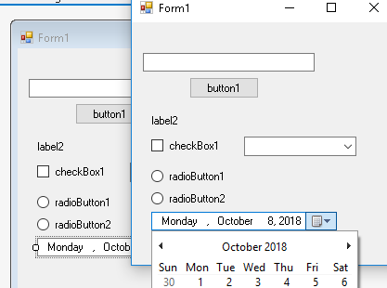
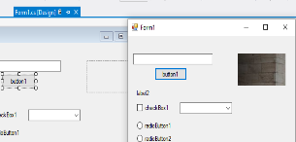
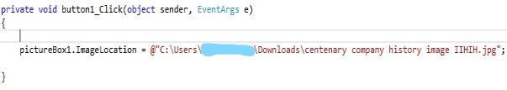
Control Details
DateTimePicker : A DateTimePicker control allows users to select a date and time in Windows Forms applications.
PictureBox : PictureBox control is used to display images in Windows Forms.
Image Location

Slide 15
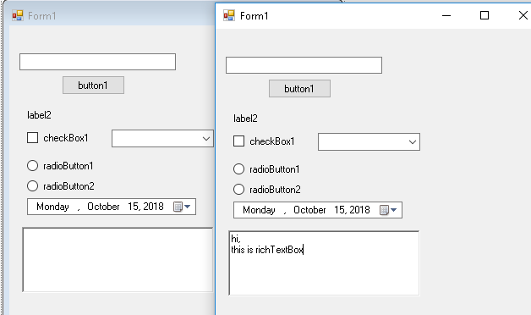
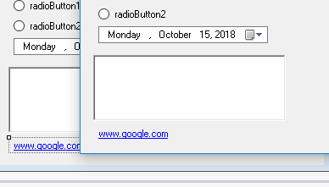
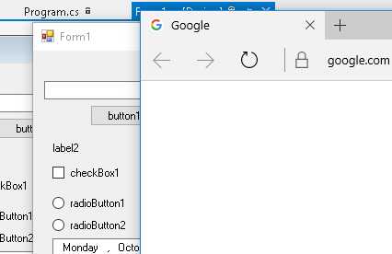
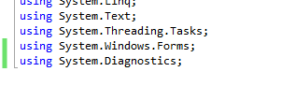
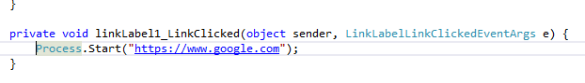
Control Details
RichTextBox : RichTextBox has many formatting options. It applies colors, background colors, multiple fonts, and margins to the text. It adds more complexity than the regular TextBox. But the RichTextBox provides needed features to programs.
richTextBox
LinkLabel : A LinkLabel control is a label control that can display a hyperlink. A LinkLabel control is inherited from the Label class so it has all the functionality provided by the Windows Forms Label control. LinkLabel control does not participate in user input or capture mouse or keyboard events.

Slide 16
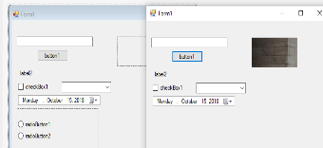
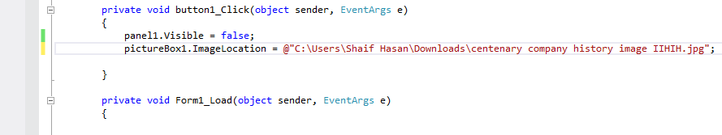
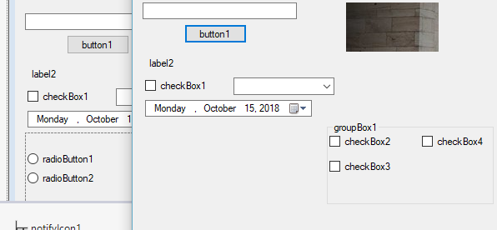
Control Details
Panel : The Panel Control is a container control to host a group of similar child controls. Panel Control is useful when you need to show and hide a group of controls.
For hiding or showing controls
GroupBox : A GroupBox control is a container control that is used to place Windows Forms child controls in a group. The purpose of a GroupBox is to define user interfaces where we can categorize related controls in a group.

Slide 17
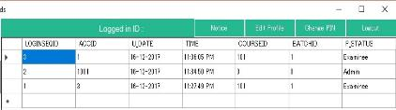
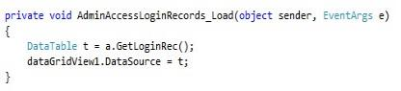
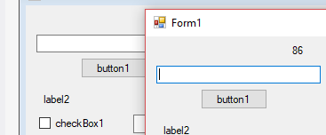
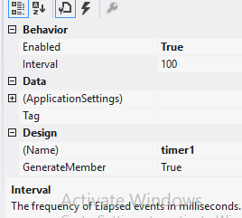
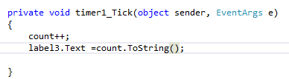
Control Details
DataGridView : DataGridView displays data from SQL databases.
Timer : The Timer control allows you to set a time interval to periodically execute an event at a specified interval. It is useful when you want to execute certain applications after a certain interval.
Timer

Slide 18
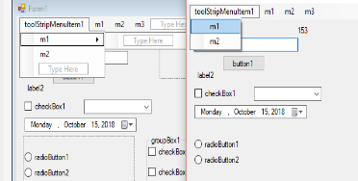
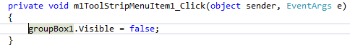
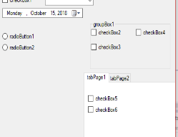
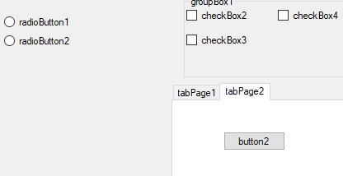
Control Details
MenuStrip : New way to create menus in C# and WinForms is using MenuStrip control.
MenuStrip click event
TabControl : The TabControl manages tab pages where each page may host different child controls.

Slide 19
Control Details
User Define Events
In general terms, an event is something special that is going to happen. For example, Microsoft launches events for developers, to make them aware about the features of new or existing products. Microsoft notifies the developers about the event by email or other advertisement options. So in this case, Microsoft is a publisher who launches (raises) an event and notifies the developers about it and developers are the subscribers of the event and attend (handle) the event.
A custom class can also have an event to notify other subscriber classes about something that has happened or is going to happen.
Lets see an Example

Slide 20
Click on the picture for visual example

Slide 21
User Controls
Advantages
Code re-usability.
Time saving.
Less effort.
Easy to find Bug and fix it.
Save memory also.

Slide 22
Example
Click on the picture for visual example

Slide 23
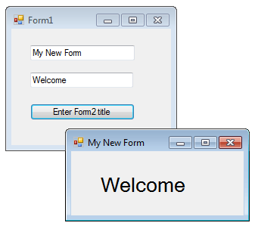
Multiple Forms
In order to communicate between the forms, we need to use the Forms constructor to send these values. Constructors performs initialize the data members of the new object and it has the same name of the class.
public MyNewForm(string title,string txt)
{
InitializeComponent();
this.Text = title;
label1.Text = txt;
}

Slide 24
Conclusion
These are some common Controls that are shown in above slides. You can search for other controls and their details using the books and references.

Slide 25

Thank You

Slide 26
Books
C# 4.0 The Complete Reference; Herbert Schildt; McGraw-Hill Osborne Media; 2010
Head First C# by Andrew Stellman
Fundamentals of Computer Programming with CSharp – Nakov v2013

Slide 27
References
https://docs.microsoft.com/en-us/visualstudio/ide/step-1-create-a-windows-forms-application-project?view=vs-2019
https://docs.microsoft.com/en-us/visualstudio/ide/create-csharp-winform-visual-studio?view=vs-2019
https://www.guru99.com/c-sharp-windows-forms-application.html
https://en.wikipedia.org/wiki/Windows_Forms
https://www.geeksforgeeks.org/introduction-to-c-sharp-windows-forms-applications/
http://csharp.net-informations.com/gui/cs_forms.htm

